Slide 1
About Me
Tips on how to use Naviance to prepare for your future
Presented by CMW for naviance night 2/12/15

Slide 2
Overview
The “About Me” tab encompasses many things:
Success Plan- setting goals
My Assessments- explore your strengths and career interests
Interesting Things About Me- a place to keep your resume and information on future plans
Official Things- find your SAT/AP/ACT test scores, GPA and keep your email up to date

Slide 3
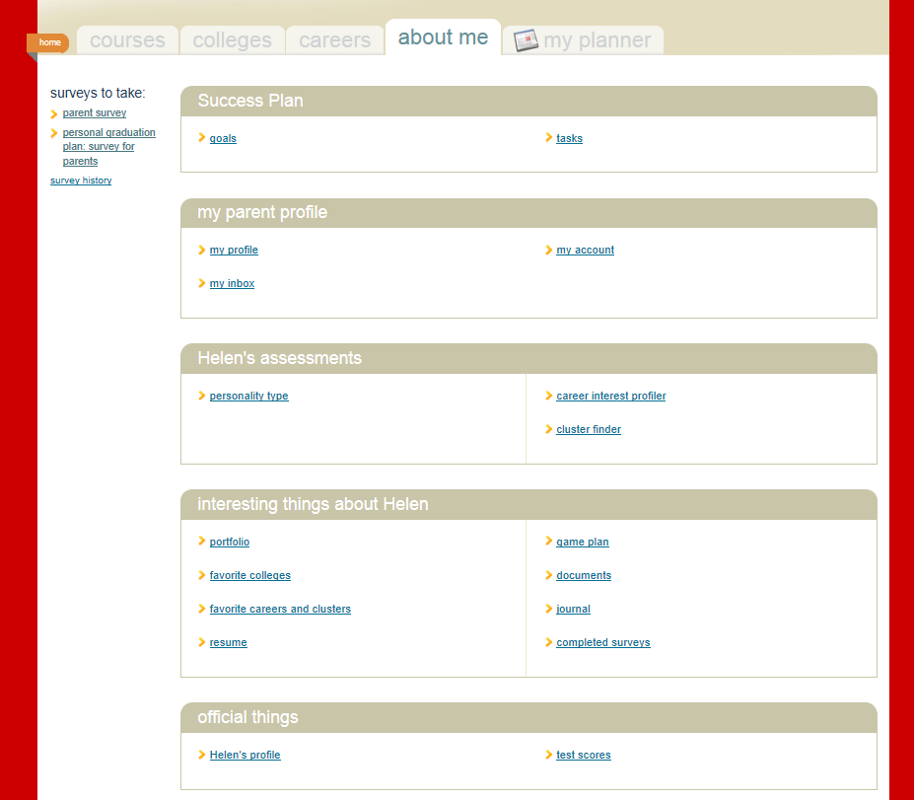
Navigating Naviance: About Me
Click the Profile to see your student’s GPA and Rank
*Students are not given a rank until the Junior year
Click here to see your child’s PSAT, AP, SAT, and ACT scores

Slide 4
Portfolio
The Portfolio option includes everything!
Take some time to view your student’s Portfolio.
If there are sections that are not complete, encourage your child to complete them. The more information a student adds to Naviance, the more effective it will be in helping them plan for their future.
It is important for your students to start planning for their future NOW! Their plans may change many times over the span of high school, but it helps to start considering where they are headed by using the tools in Naviance.

Slide 5
Getting started
Log on
Under “Official Things” click on profile and check to be sure your email address is correct. If not, take time to edit it.
Under this option you will also find your student’s GPA. GPA’s only include school years that are completed.
Click on test scores to view your student’s scores.

Slide 6
Transcripts
What do they include?
Grades
GPA
Attendance
Strength of schedule
Credits earned
Does NOT include test scores

Slide 7
A Typical Tenth Grade Schedule at CMW
Course Final Points Credit
3D Design A 4.0 1.0
Alg II B 3.0 1.0
AP World B 4.0 1.0
English II B 3.0 1.0
Found Tech B 3.0 1.0
French 2 C 2.0 1.0
Guitar Lab A 4.0 1.0
Hon. Bio B 3.0 1.0
GPA=Total Points ÷ 8
3.25

Slide 8
Weighted Grades and Ranks:

Slide 9
Resume vs. Brag Sheet
Resume
Brag sheet
A student can start filling this out in 9th grade
Covers work, extracurricular and schooling
May be requested by colleges and employers
May be completed only in 11th and 12th grade
Describes student’s personality, traits, hopes and plans for the future
Will only be seen by C Milton Wright and is often used to help teachers and counselors write a solid recommendation letter.

Slide 10
ACTION STEPS
Review all student data (address, contacts, scores, assessments
Discuss course selections with your student
Determine a testing plan
Document accomplishments and growth using the brag sheet (11th and 12th) or the resume (all grade levels)

