Slide 1
Counseling in the Digital Age
David Michael Whitfield Johns Hopkins School Counseling Fellow 4.0 School Counselor @ C. Milton Wright High School David.Whitfield@hcps.org

Slide 2
Presentation Objectives
Counselors will understand the importance of using online technologies to increase the efficacy of their counseling program.
Counselors will know how to set up accounts on at least 3 different technological systems demonstrated in the presentation.
Counselors will know how to advocate for the use of this technology with their students, families, and school staff so that the efficacy and utility of the technology is ensured.

Slide 3
Before we start…. Let’s do some Introductions!
The more I know about you- the more I can tailor this presentation to your needs.
As we go around, please let me know:
your name and school
your approximate case load size
One thing you are interested to learn about in terms of technology for counselors.

Slide 4
Presentation Format
I will show you a few pieces of Technology
I will explain each one and what it is good for
You will have a few minutes to pick one piece of that technology and play with it
Questions and Answers
Repeat

Slide 5
The Fact of Technology Proliferation
Currently, approximately 70 percent of the U.S. population has Internet access.
Similarly, estimates indicate that more than 90 percent of the U.S. population under age 45 has their own cell phones.
Students, their families, our colleagues, and our world is using technological resources at an EXPONENTIALLY GROWING RATE

Slide 6
Why should Counselors care?
Technology increases your reach
Technology makes your work more efficient
Technology is being used by your students- the more you know, the more you can help
Technology makes you look as good as you are, not just in observations, but for the world!

Slide 7
What exists that helps counselors?
Think about these categories:
Intra-office sharing (Handled by Office365)
Data Collection!!!
Communications
classroom lessons
college and career exploration
promotion of profession

Slide 8
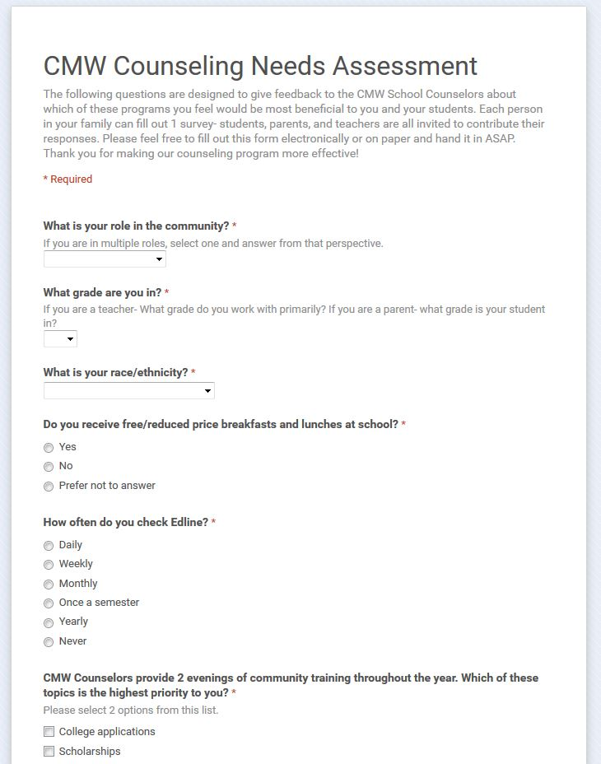
Data Collection- Never Easier than GooglE Forms!
Excel surveys in Office 365 are good, but the google surveys have more options, flexibility, and accessibility
Each survey you create automatically generates a responses chart which Google will analyze for you using the Explore tool (so you don’t need to be an excel genius).
Google surveys, spreadsheets, and other forms can be shared just as easily as in the Office365 platform
Surveys have customizable themes and come free with a google account!

Slide 9
Here’s a Real Example!
Go here and check out the CMW Community Needs Assessment from This Year:
http://tinyurl.com/CMWNeeds
(That custom link maker is something I show the resource for at the end of the talk)

Slide 10
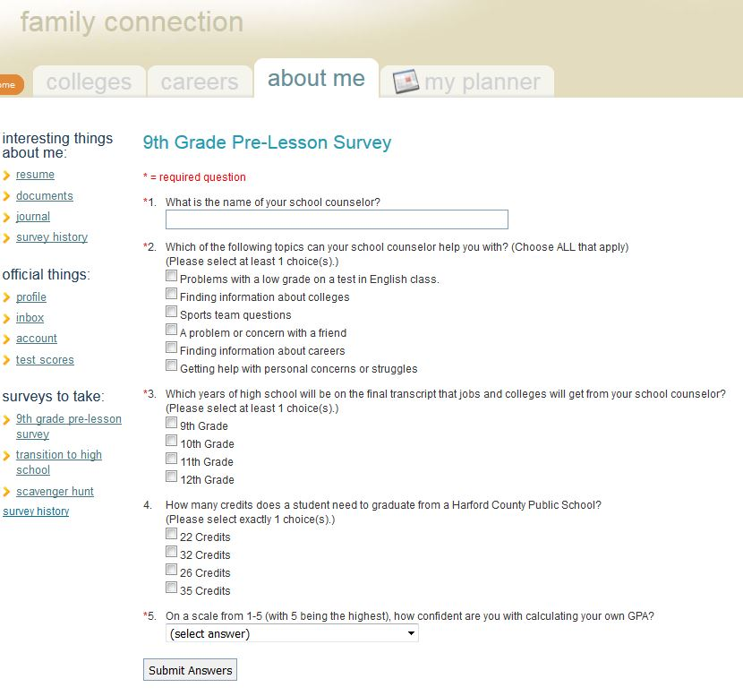
Collecting Data Naviance Surveys
All our students and counselors have access to the system already
Data can be quickly analyzed and disaggregated for you by naviance
The system can cue students to take it or be deactivated with a few button clicks
Results and surveys are automatically available to everyone in your department
It is slightly less powerful and flexible than Excel or Google, but it is easy to setup and already on a site that kids are using.

Slide 11
Check out the following slide from a data presentation built with Naviance Survey results!
You can check out http://cmwcounseling.weebly.com/cmw-counseling-data.html For Presentations on what we are doing at any time at CMW.

Slide 12
Pre-Post Data Comparisons by Objective
Post-Lesson Survey
How many students know how many credits they need to graduate?
Pre-Lesson Survey
How many students know how many credits they need to graduate?
(That means that nearly 100% of freshmen students can now correctly identify graduation requirements, and it’s 3% higher than it was last year!)

Slide 13
Data Collection- independent Work time
Option 1- Make your Own Google Account and make a Survey
Go to www.gmail.com
Make your account
Go to Google Drive
Make a new Survey
Edit and send out a survey
Option 2- Make a Naviance Survey
Go to www.succeed.Naviance.com
Log in to the system, click on Connections and select Surveys
Make a new pre-post survey for your next classroom lesson

Slide 14
Questions and Answers

Slide 15
Communications Tech- Remind! (formerly Remind101)
Remind is a service that families can sign up for to receive texts from you
Remind keeps your number hidden and their number hidden, so it’s secure
Remind can be done from a phone or computer
Remind can attach calendars and document reminders
Remind is FREE for educators!
You email them a code, they text the code to a number, and then you’re connected! So SIMPLE!

Slide 16
Communications Tech- Twitter
Twitter is free, fast, and utilized by MANY PEOPLE.
Twitter is not going away soon- why not use it?
Twitter has it’s own language, but you don’t need to know it perfectly to start using it
Twitter is a source of great information if you know how to use it.

Slide 17
Communications Tech- Twitter Crash Course
Tweet- Message posted on Twitter with 140 characters or less
Hash Tag- Words that follow a # sign that create a clickable link to see other posts with that same tag
Following- Like friending, gives you notifications and sends your notifications
Tagging- using someone’s Twitter name in your post for various reasons
Go here for more help: https://media.twitter.com/the-basics

Slide 18
Communications Tech- Websites
Websites are no longer things you must be able to code to create- they are free and easy to set up
These three platforms all make website building flexible and fun
Weebly is the one I use to make our website
These sites can become the portal by which you can interact with the community

Slide 19
Communications Tech- CMW Example
Go to www.cmwcounseling.weebly.com and check out the school counseling website that we have been using.
Find one thing you like and one thing you would change!
Or you can follow us on Twitter @CounselingCMW

Slide 20
Communications Tech- Independent Work time
Option 1- Make a Remind Account, send out a test reminder to yourself
Go to www.remind.com to make your account and create your group/code
Text that code from your phone, and then use your account to send yourself a reminder!
Option 2- Create a Twitter and account and send your first Tweet
Go to www.twitter.com and create a new username that represents your counseling department
Send out your first tweet and tag @CounselingCMW in the post!
Option 3- Open an account at a website builder, start making your site
I recommend using www.weebly.com and starting with a title page
Use ideas from my website for yours- the sky is the limit!

Slide 21
Questions and Answers

Slide 22
Classroom Lessons Tech- Go.Soapbox.com
GoSoapBox is an online platform that enables you to make classroom lessons quickly and easily!
Surveys, quizzes, and polls can be done in real time by phone or by computer.
The “I’m Confused” button gives you an instant barometer of your classroom.
The program gives you graphs of your respondent’s progress quickly and easily!

Slide 23
Classroom Lesson Tech- Naviance Surveys
Naviance has MANY features, but for classroom lessons, the surveys are EXCELLENT!
You can create one survey, copy it, and enable them when you are ready for a pre/Post Survey.
The surveys give outcome data graphs- Perfect for publishing to the community to show what your kids can do!
Naviance Surveys can be set to be accessed by the entire community so that you can see the data on a school level.

Slide 24
Let’s Test our System- Would you rather see a brief Tutorial of Naviance or GoSoapBox?
Go to app.gosoapbox.com
Enter code “HCPSCounselorpd”
Enter your name
Take the Poll!

Slide 25
Classroom Lessons Tech- Independent work Time!
Option 1: Create an account at GoSoapBox.com, make a practice quiz or survey for your next lesson
www.gosoapbox.com
Make an account
Create an event
Make a poll
Test it on your phone or computer!
Option 2: Get on your naviance, and start or continue making a pre/post survey for your next classroom lesson in the fall!
www.succeed.naivance.com
Go to the Surveys Tab
Make your survey
Duplicate it for the post survey!

Slide 26
Questions and Answers

Slide 27
College and Career Tech- Naviance
Naviance has THOUSANDS of colleges and Careers in a database for you- are you using it to the best of your ability?
Do you instruct your students on:
Supermatch?
Interest Inventories?
The Career Information Tabs?
There are dozens of slides to teach Naviance basics to parents and students- feel free to get them from Naviance whenever you need them!

Slide 28
College and Career- Webquests
There are dozens of counselor blogs online that have created resources for you to use with your students
Here is a link to one that can be used in a self-directed way at multiple grade levels
A google search for College and Career resources for school Counselors goes a LONG way.
http://platte1.k12.wy.us/WHS/CollegeWebquest/

Slide 29
College and Career- Other Free Things!
Check out the following online tools to help students find their way:
The Big Five- A free personality Type Survey for Career profiling
http://www.truity.com/test/big-five-personality-test
MyFuture- A website that collects information about various jobs by salary, growth and more
http://www.myfuture.com/careers/
My Next Move- O*NET Produced Service that helps match you with careers
http://www.mynextmove.org/explore/ip

Slide 30
College and Career Independent Work time
Option 1- Explore Naviance Materials and Test a tool
Log back into Naviance
Select the supermatch, Career Interest Surveys, or another feature you have, and practice using it
Make a plan for how to use it with your community (or build a survey on it)
Option 2- Take the webquest
Go to this website
Take the webquest
Decide how to use it with students OR make your own webquest
Option 3- Play with one of the free surveys/Tools provided on the last slide
Decide how you could or could not use this with kids
Google for more free resources!

Slide 31
Questions and Answers

Slide 32
Promoting the Profession- Twitter
Using Twitter instantly Connect you with your Peers
It can create a web-presence for our often neglected profession
Following leaders like Dr. Trish Hatch, Dr. Ileana Gonzalez, or the hashtag #scchat can give you resources and information for your program!

Slide 33
Promoting the Profession- Take a Resource, Give a resource

Slide 34
Promoting the Profession- Make your Web Presence Known!

Slide 35
Last independent Work Time!
Option 1- Connect to new people on Twitter or post something about this Presentation to the #SCCHAT hashtag so that we can show others what we are doing!
Option 2- Google School Counselor blogs for your content area, grade level, or school type and steal ideas for yourself
Later, when you have a minute- give some back!
Option 3- Go back to your new website and make the title page presentable so that people can interact with your counseling program on the web!

Slide 36
Questions and Answers

Slide 37
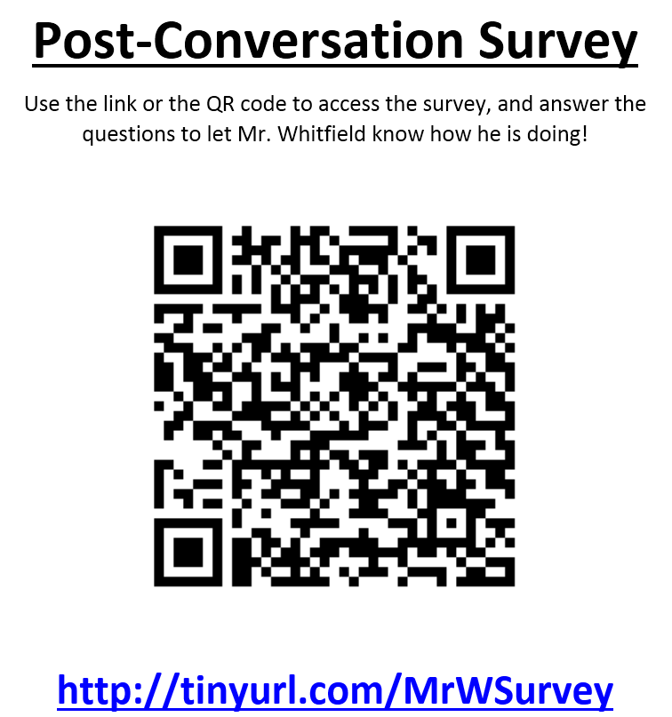
Technologies that we did not cover (But that you should know about!)
Tinyurl.com- A website that can convert long addresses into short ones
Google Docs- Use the forms for Surveys, Spreadsheets for Data
Example: www.tinyurl.com/MrWSurvey
www.qr-code-generator.com - Create Codes that can be scanned to link to websites

Slide 38
Technology usage In Counseling- Selling those who are not Open to it
First- Use Tech to reduce their struggles or demonstrate how effective what they are doing is (i.e. make them look good!)
Second- Introduce one, SMALL tech shift, then keep careful data on how well it works
Third- Based on your earlier successes, show them what else you can do to help kids!
Surveys, Websites, and Twitter are all EASY places to start!

Slide 39
Post- Lesson Survey
Go back to the app.gosoapbox.com website
Enter Code “HCPSCounselorPD”
Take the post-lesson Survey
When you are finished, take any notes you need, and work on the tech you want to use at your school!

Slide 40
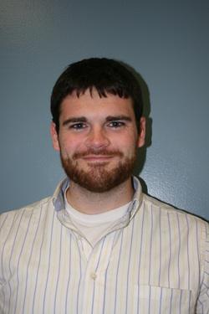
Contact information
David Michael Whitfield
David.Whitfield@hcps.org
410-638-4270
School Counselor, C. Milton Wright High School
Follow us @CounselingCMW or www.cmwcounseling.weebly.com

Slide 41
If we have extra time- Use it and use me AS a resource! Otherwise, Take care!

